Slide 1
CONCURRENCY CONTROL

Slide 2
Concurrency control
A procedure in DBMS used for managing simultaneous operations without conflicting each other.
Quite easy if all users are reading data as only retrieve operation is performed.
Concurrency control is mainly designed to manage conflicts in multi-user systems.
It ensures that database transactions are performed concurrently without violating the integrity of the database.

Slide 3
Need of concurrency control
To apply Isolation through mutual exclusion between conflicting transactions.
To resolve read-write and write-write conflict issues.
To preserve database consistency through constantly preserving execution obstructions.
Concurrency control helps to ensure serializability.
The system needs to control the interaction among the concurrent transactions. This control is achieved using concurrent-control schemes.

Slide 4
Example
Assume that two people who go to electronic kiosks at the same time to buy a movie ticket for the same movie and the same show time.
However, there is only one seat left in for the movie show in that particular theatre. Without concurrency control, it is possible that both moviegoers will end up purchasing a ticket. However, concurrency control method does not allow this to happen. Both moviegoers can still access information written in the movie seating database. But concurrency control only provides a ticket to the buyer who has completed the transaction process first.

Slide 5
Concurrency Control Protocols
Different concurrency control protocols offer different benefits between the amount of concurrency they allow and the amount of overhead that they impose.
Lock-Based Protocols
Two Phase
Timestamp-Based Protocols
Validation-Based Protocols

Slide 6
Lock based
Lock is a data variable associated with a data item.
All lock requests are made to the concurrency-control manager. Transactions proceed only once the lock request is granted.
Binary Locks: A Binary lock on a data item can either locked or unlocked states.
Shared/exclusive: This type of locking mechanism separates the locks based on their uses. If a lock is acquired on a data item to perform a write operation, it is called an exclusive lock.

Slide 7
1. Shared Lock (S):
A shared lock is also called a Read-only lock. With the shared lock, the data item can be shared between transactions. This is because you will never have permission to update data on the data item.
For example, consider a case where two transactions are reading the account balance of a person. The database will let them read by placing a shared lock. However, if another transaction wants to update that account's balance, shared lock prevent it until the reading process is over.

Slide 8
2. Exclusive Lock (X):
With the Exclusive Lock, a data item can be read as well as written. This is exclusive and can't be held concurrently on the same data item. X-lock is requested using lock-x instruction. Transactions may unlock the data item after finishing the 'write' operation.
For example, when a transaction needs to update the account balance of a person. You can allows this transaction by placing X lock on it. Therefore, when the second transaction wants to read or write, exclusive lock prevent this operation.

Slide 9
3. Simplistic Lock Protocol
This type of lock-based protocols allows transactions to obtain a lock on every object before beginning operation. Transactions may unlock the data item after finishing the 'write' operation.

Slide 10
4. Pre-claiming Locking
Pre-claiming lock protocol helps to evaluate operations and create a list of required data items which are needed to initiate an execution process. In the situation when all locks are granted, the transaction executes. After that, all locks release when all of its operations are over.

Slide 11
Problems
Starvation
Deadlock

Slide 12
Two Phase Locking (2PL) Protocol
Two-Phase locking protocol which is also known as a 2PL protocol.
It is also called P2L.
In this type of locking protocol, the transaction should acquire a lock after it releases one of its locks.
This locking protocol divides the execution phase of a transaction into three different parts.
In the first phase, when the transaction begins to execute, it requires permission for the locks it needs.
The second part is where the transaction obtains all the locks. When a transaction releases its first lock, the third phase starts.
In this third phase, the transaction cannot demand any new locks. Instead, it only releases the acquired locks.

Slide 13
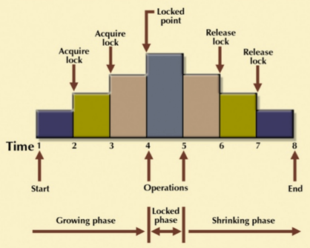
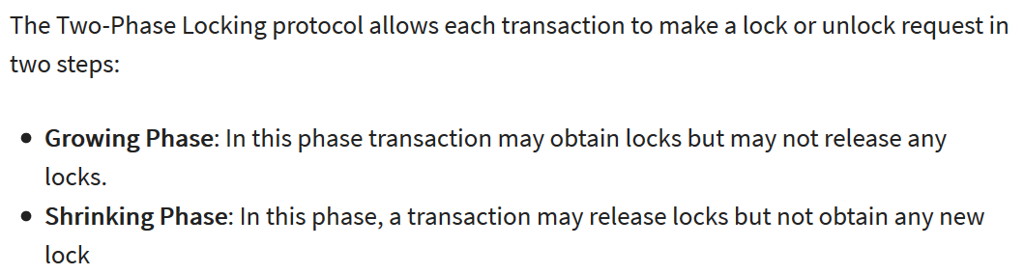

Slide 14
It is true that the 2PL protocol offers serializability. However, it does not ensure that deadlocks do not happen.

Slide 15
Strict Two-Phase Locking Method
Strict-Two phase locking system is almost similar to 2PL. The only difference is that Strict-2PL never releases a lock after using it. It holds all the locks until the commit point and releases all the locks at one go when the process is over.

Slide 16
Centralized 2PL
In Centralized 2 PL, a single site is responsible for lock management process. It has only one lock manager for the entire DBMS.
Primary copy 2PL
Primary copy 2PL mechanism, many lock managers are distributed to different sites. After that, a particular lock manager is responsible for managing the lock for a set of data items. When the primary copy has been updated, the change is propagated to the slaves.

Slide 17
Distributed 2PL
In this kind of two-phase locking mechanism, Lock managers are distributed to all sites. They are responsible for managing locks for data at that site. If no data is replicated, it is equivalent to primary copy 2PL. Communication costs of Distributed 2PL are quite higher than primary copy 2PL

Slide 18
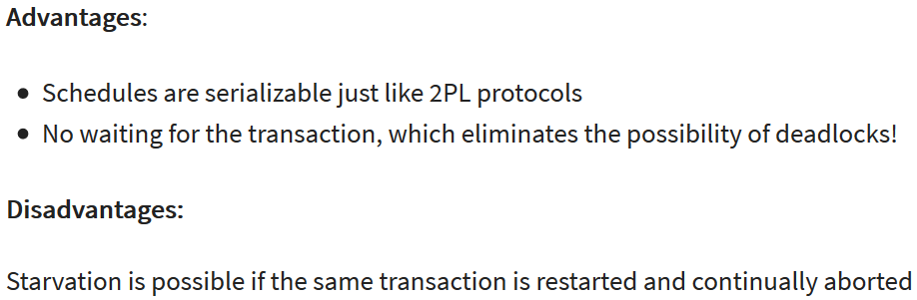
Time Stamp – based protocols
The timestamp-based algorithm uses a timestamp to serialize the execution of concurrent transactions.
This protocol ensures that every conflicting read and write operations are executed in timestamp order. The protocol uses the System Time or Logical Count as a Timestamp.
The older transaction is always given priority in this method.

Slide 19
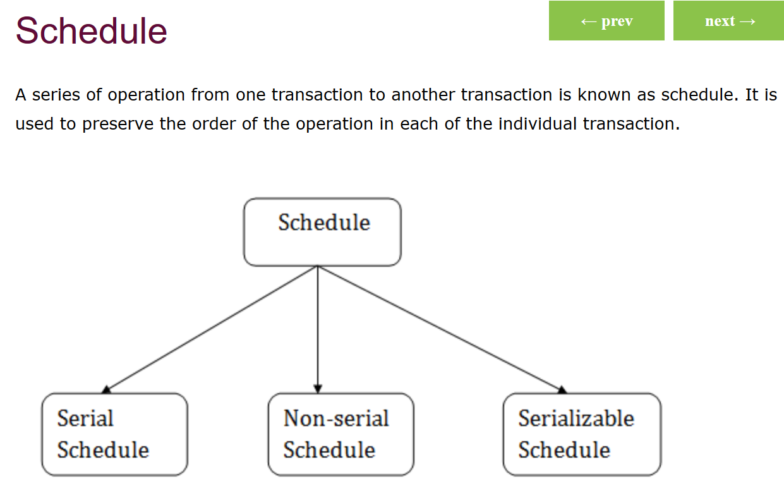

Slide 20
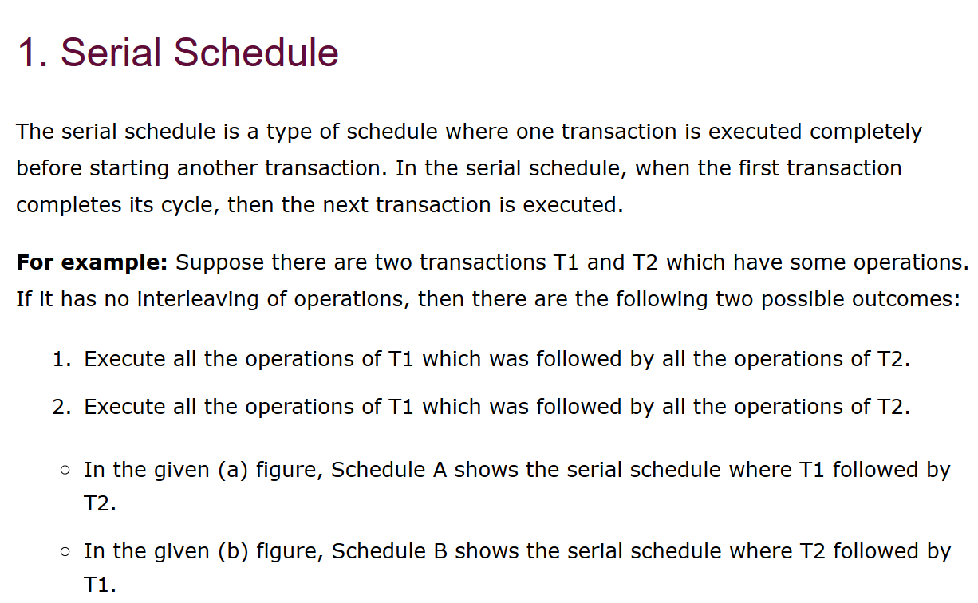

Slide 21
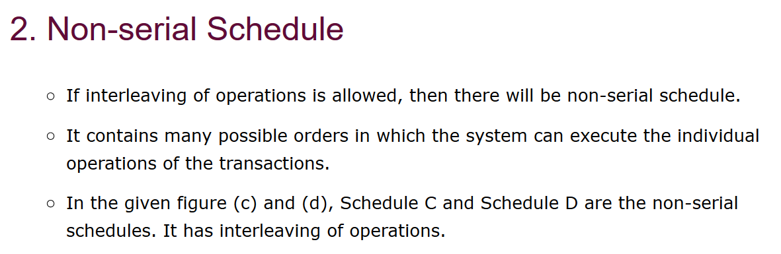

Slide 22
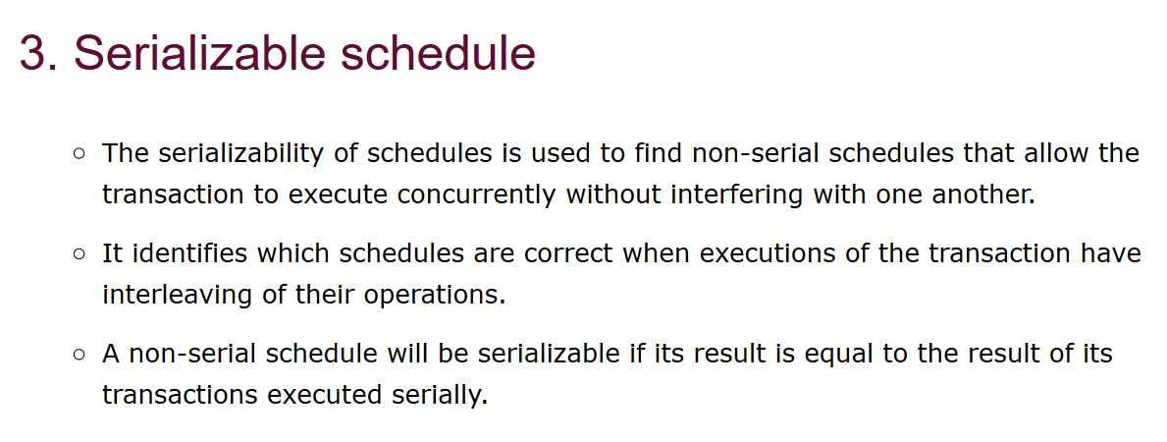

Slide 23
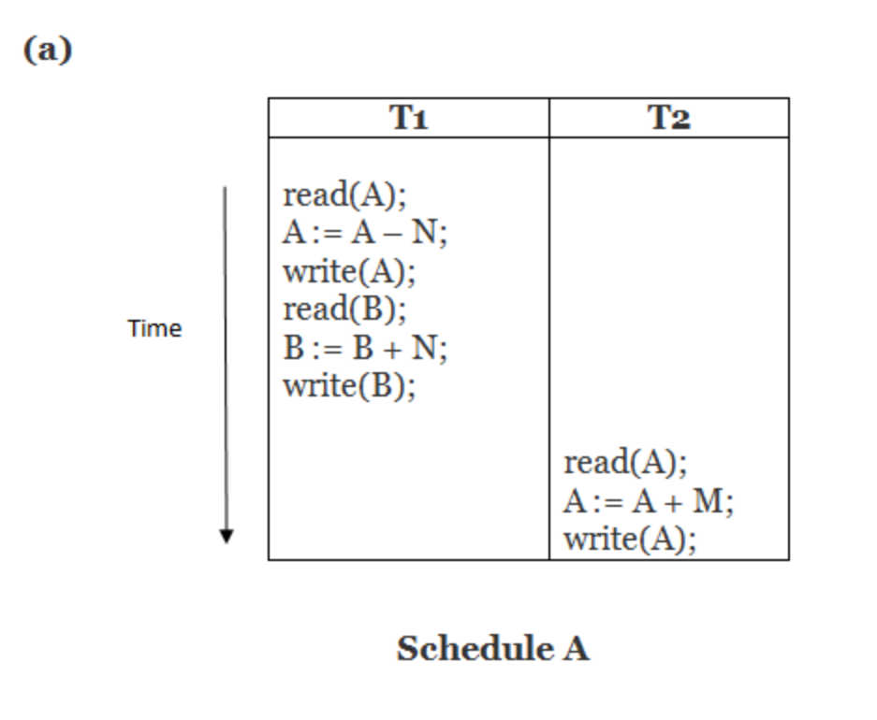
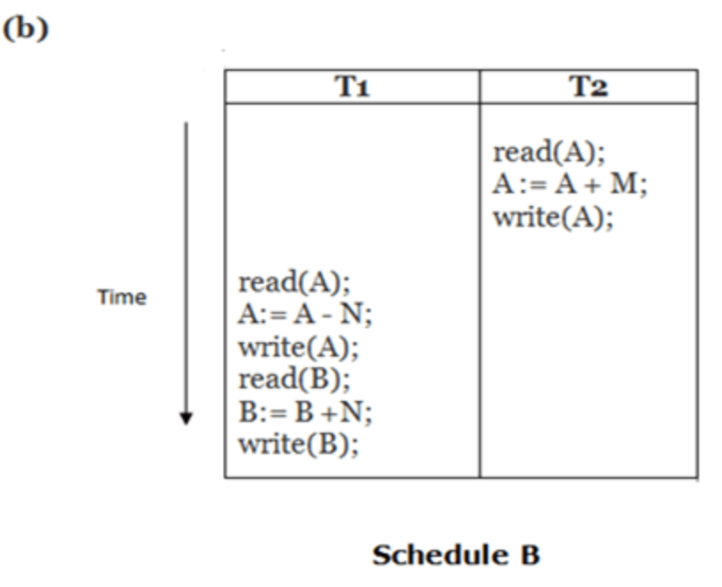

Slide 24
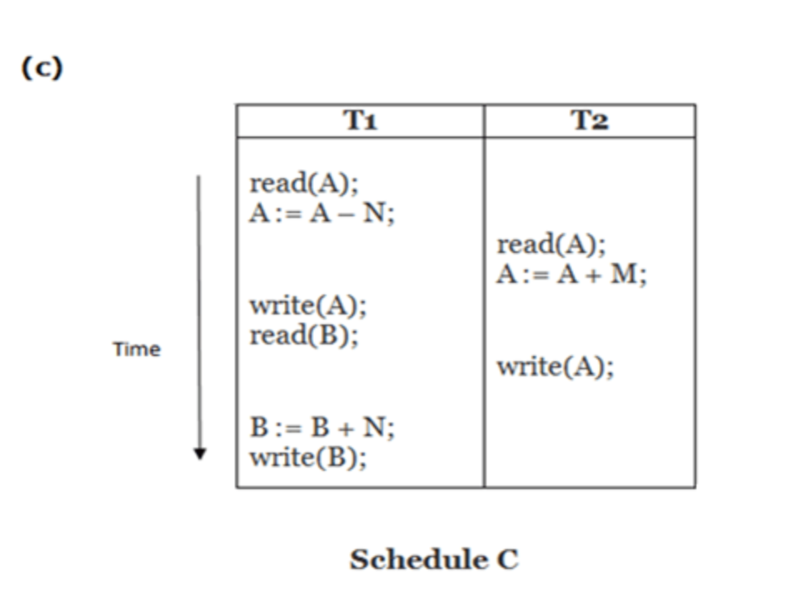
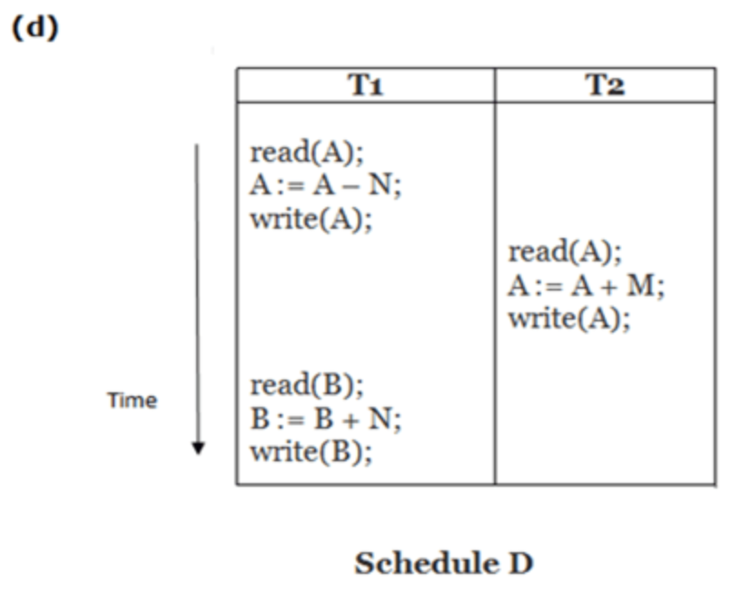

Slide 25
Here, Schedule A and Schedule B are serial schedule. Schedule C and Schedule D are Non-serial schedule.

Slide 26
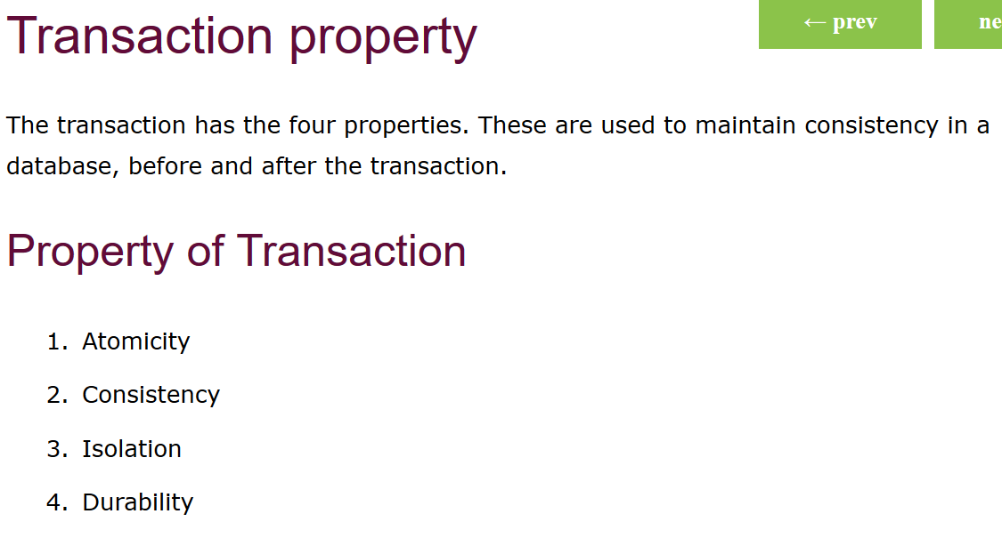

Slide 27
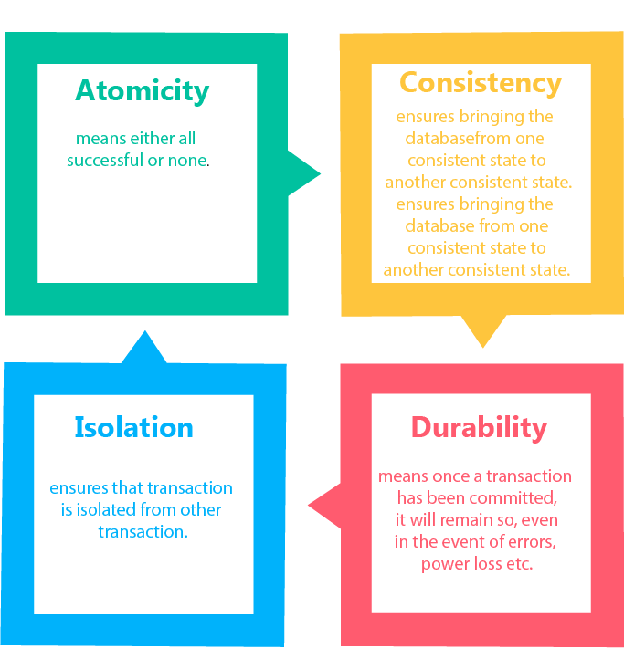

Slide 28
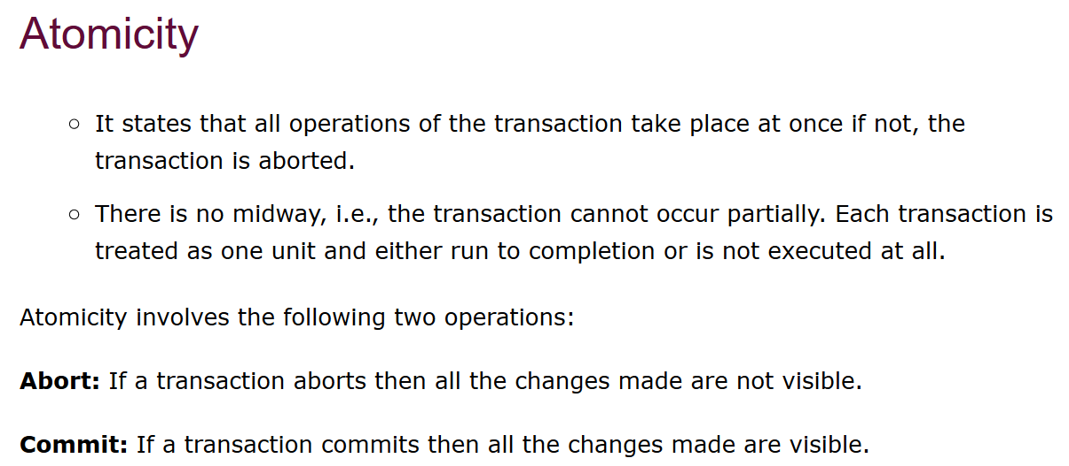

Slide 29
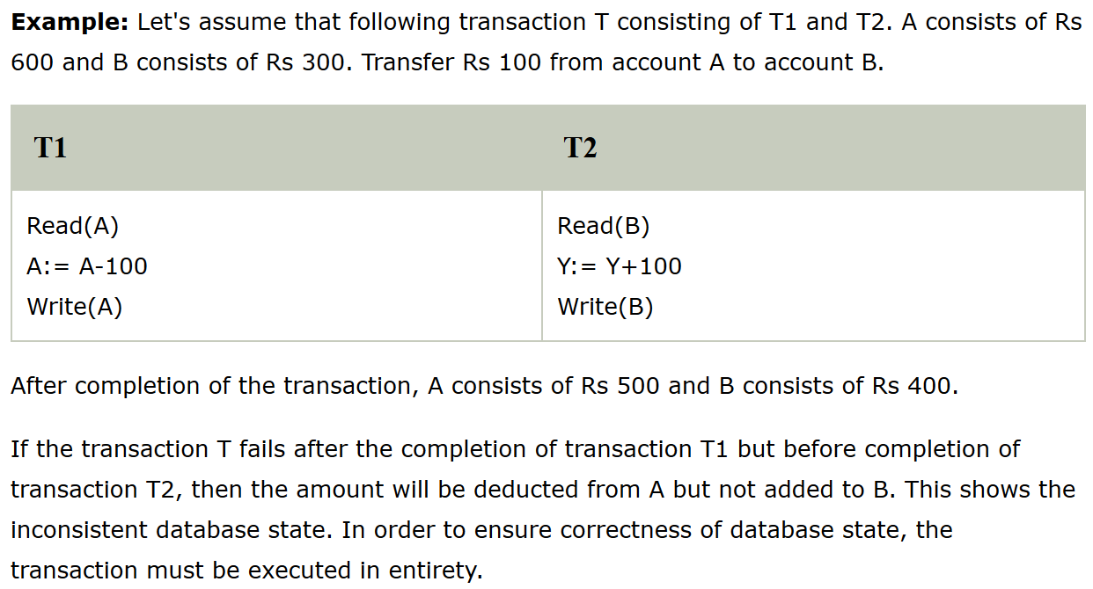

Slide 30
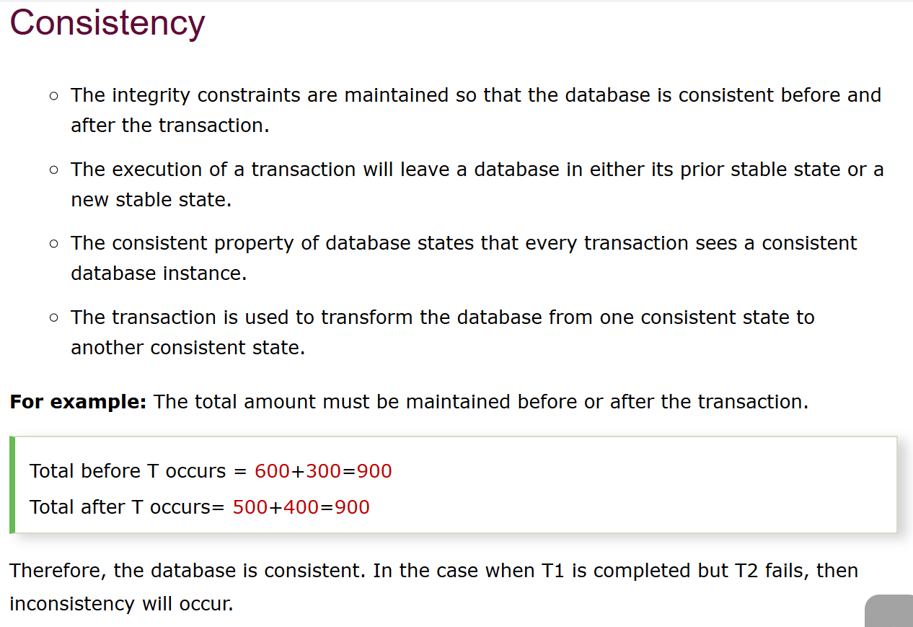

Slide 31
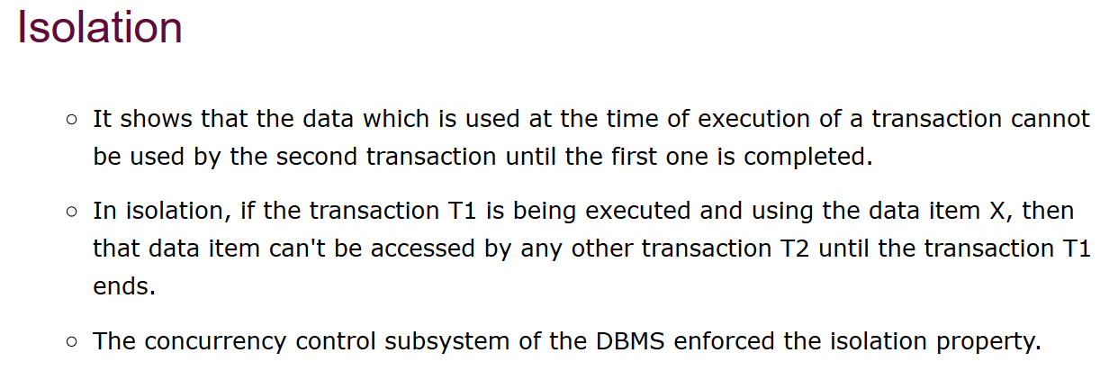

Slide 32
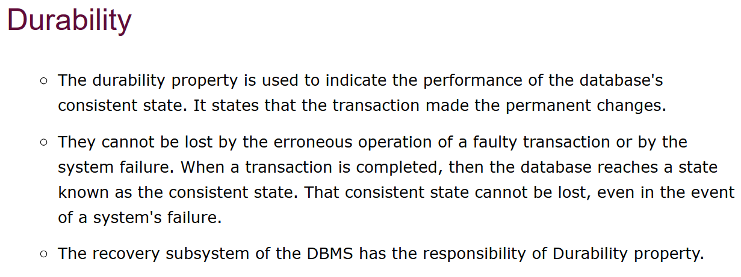

Slide 33
States of transaction https://www.javatpoint.com/dbms-states-of-transaction

